Slide 1
State changes should reflect in the UI, and data should persist across components.
Md. Tanvir Alam

Slide 2
Tools
React
Redux
React-Router
Redux-Persist
Tailwind

Slide 3
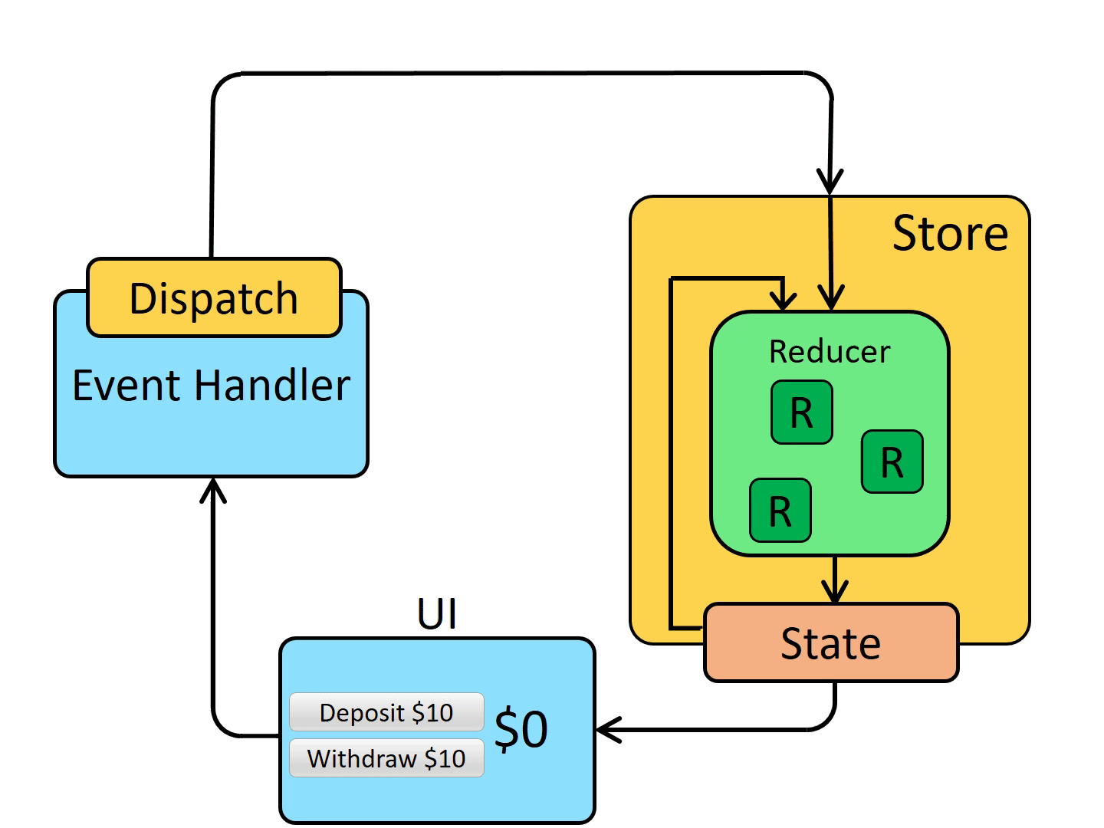
Redux workflow

Slide 4
Thank You

